Slide 1

A hedonic pricing model on Airbnb listings
Group: Tina Wang, Patrick Tawill, Waldemar Schuppli & Sofie Juel

Slide 2
Introduction

Slide 3
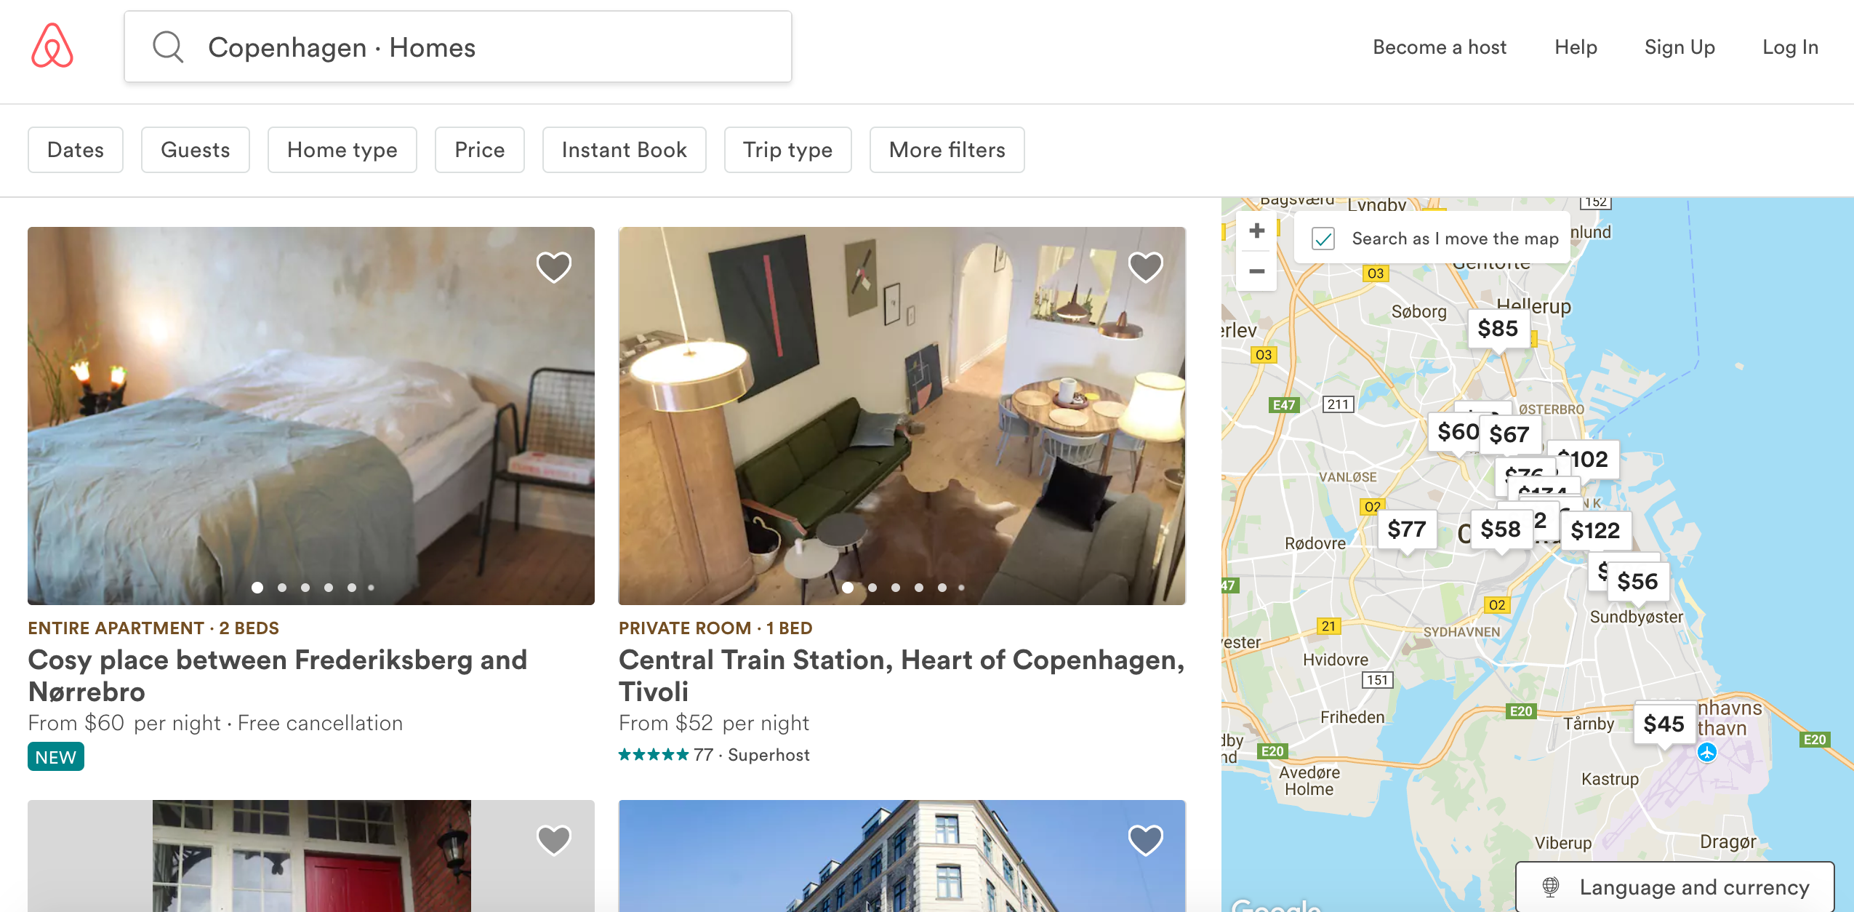

Slide 4
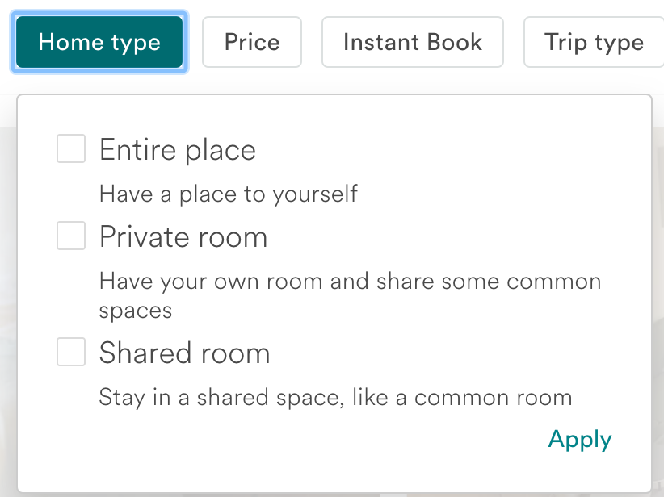
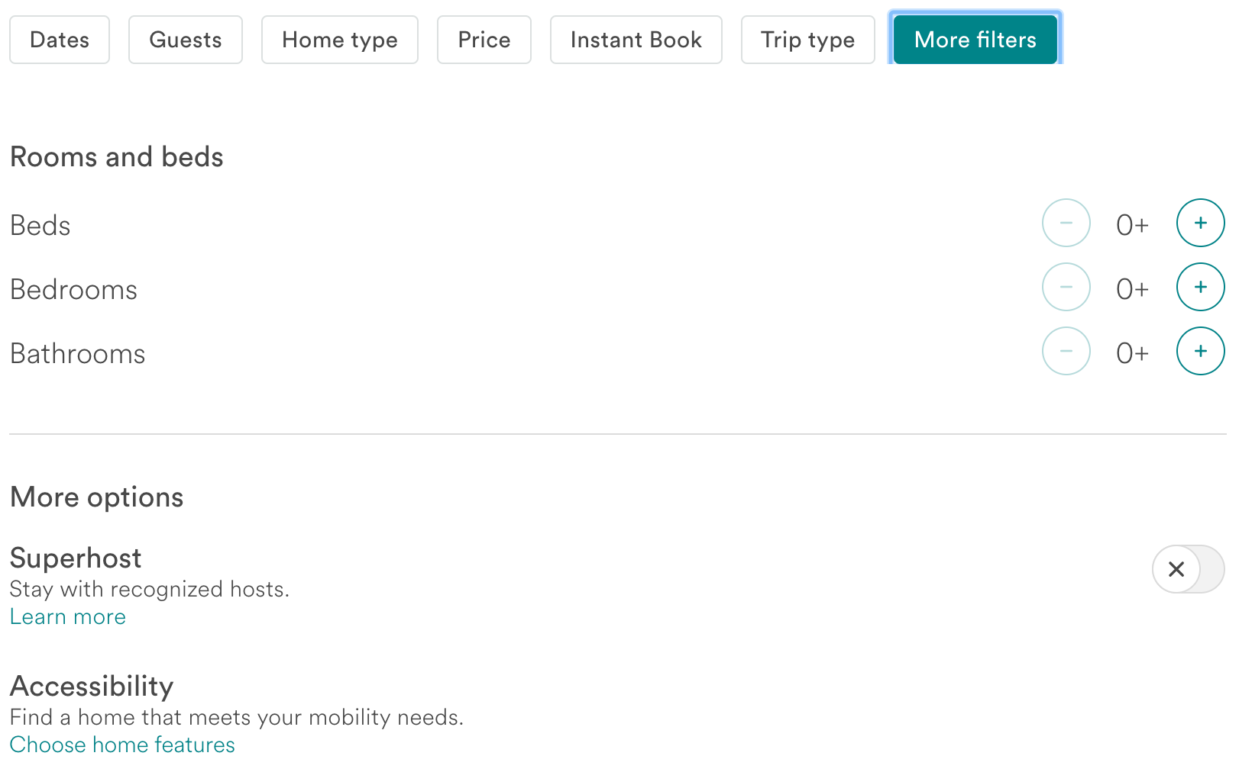
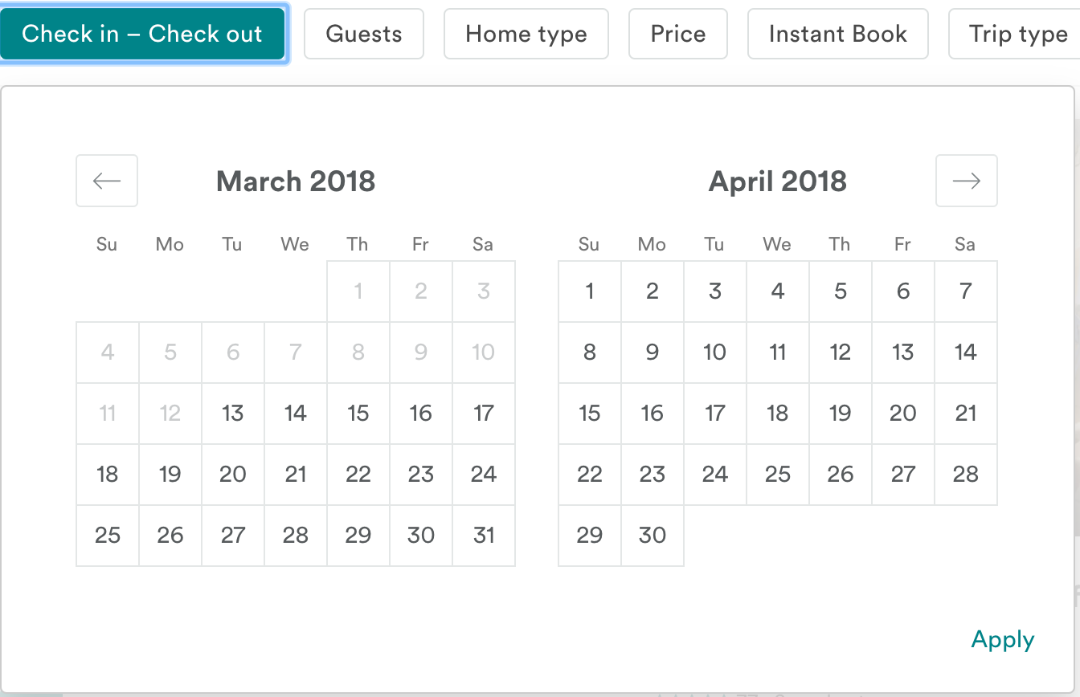
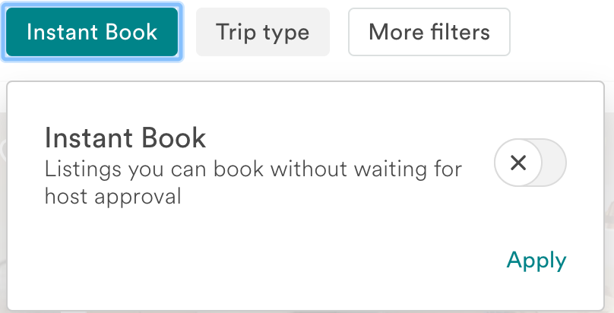

Slide 5
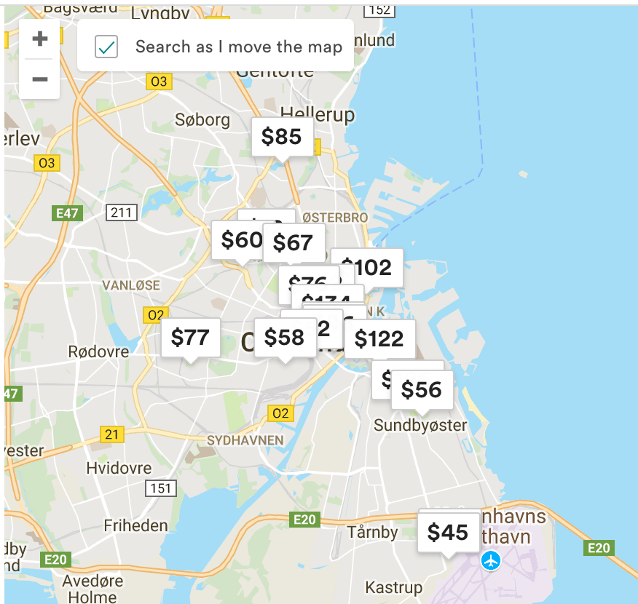

Slide 6
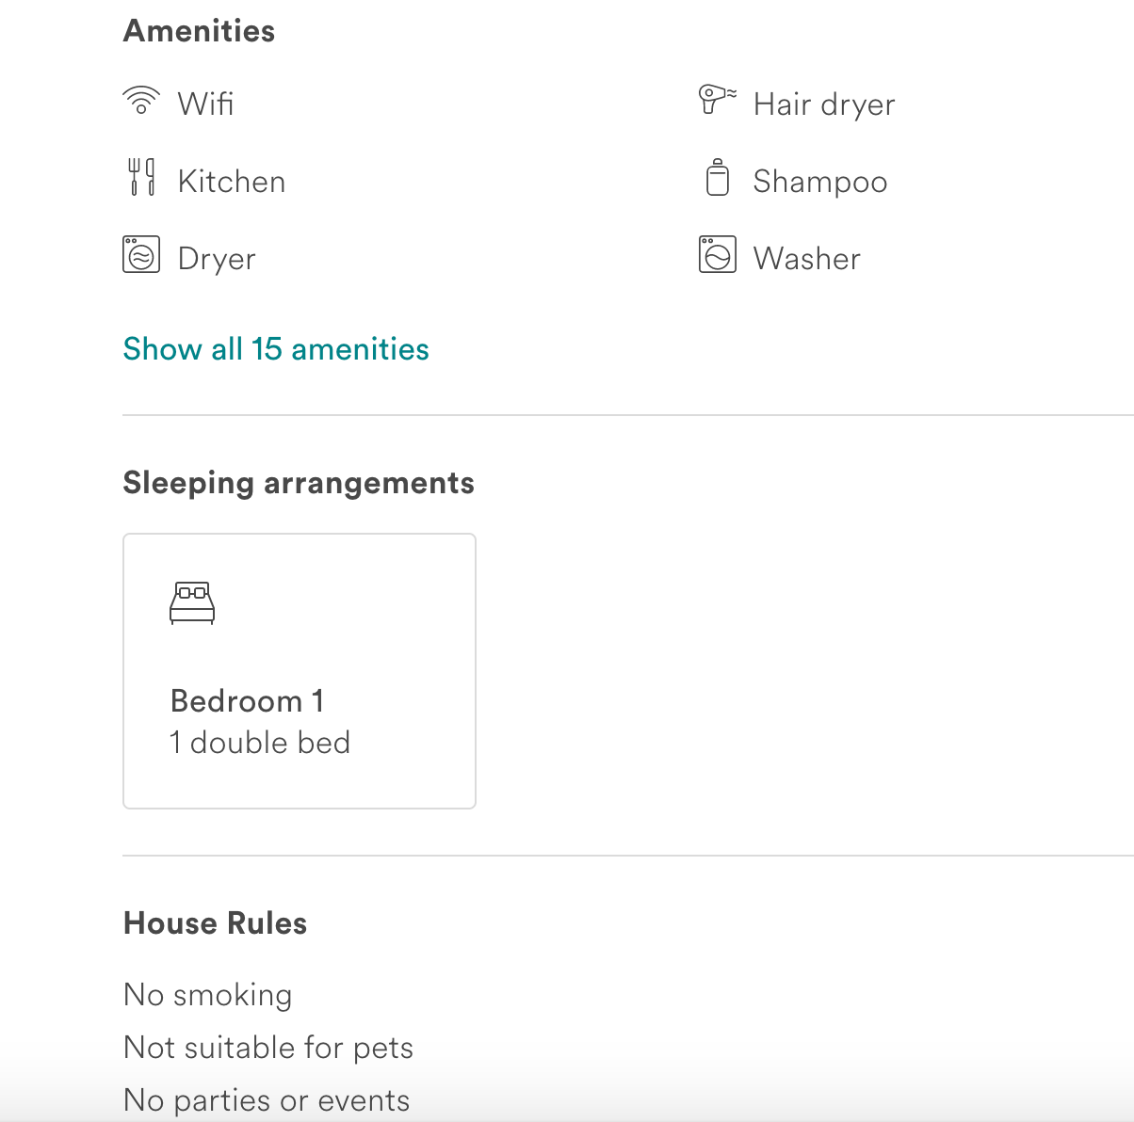
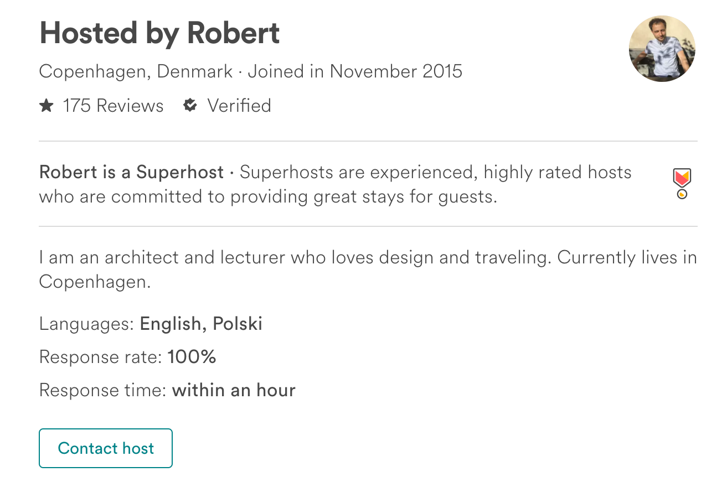

Slide 7
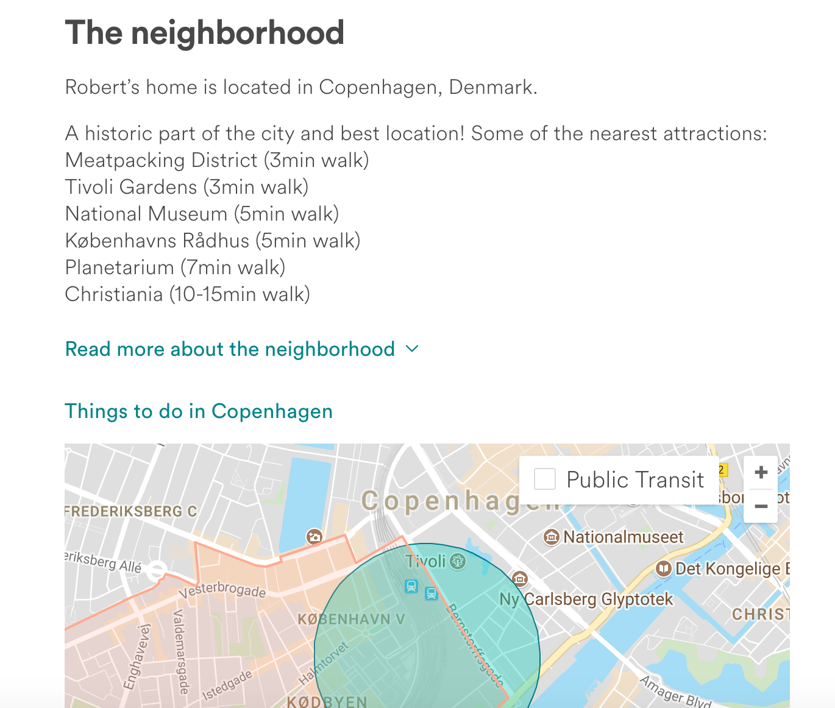
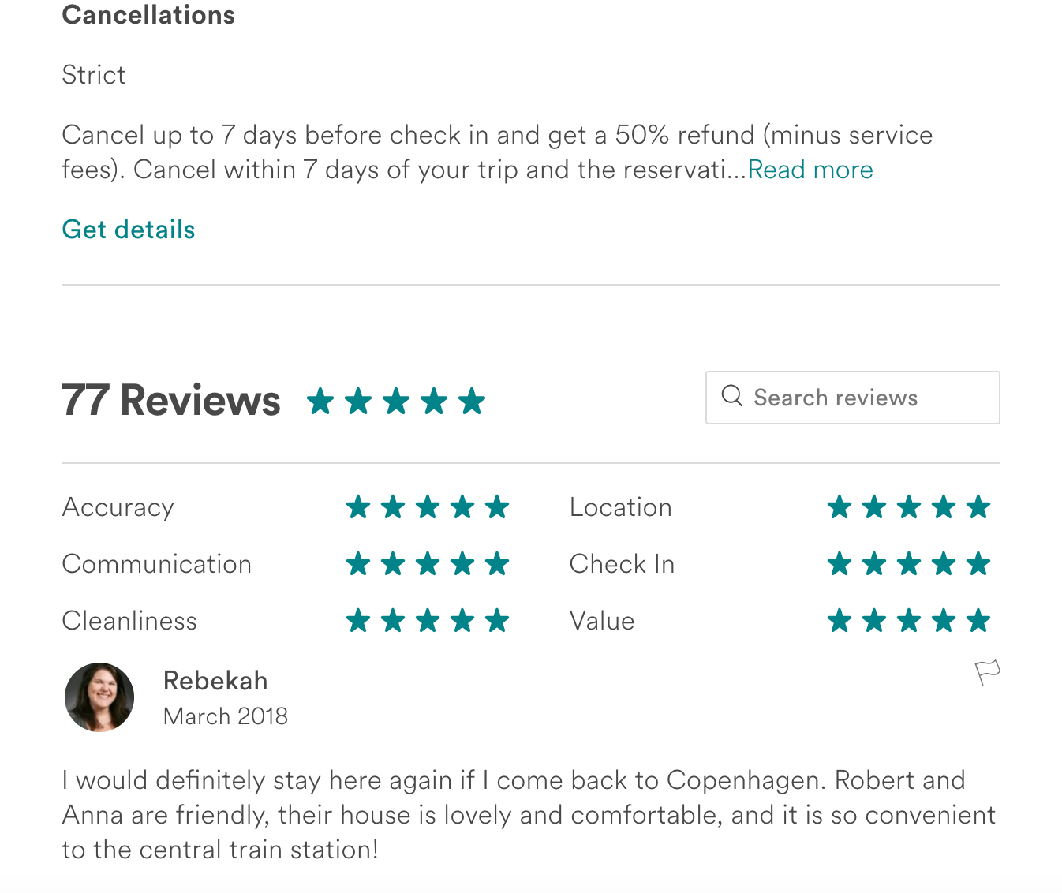

Slide 8


Slide 9


Slide 10
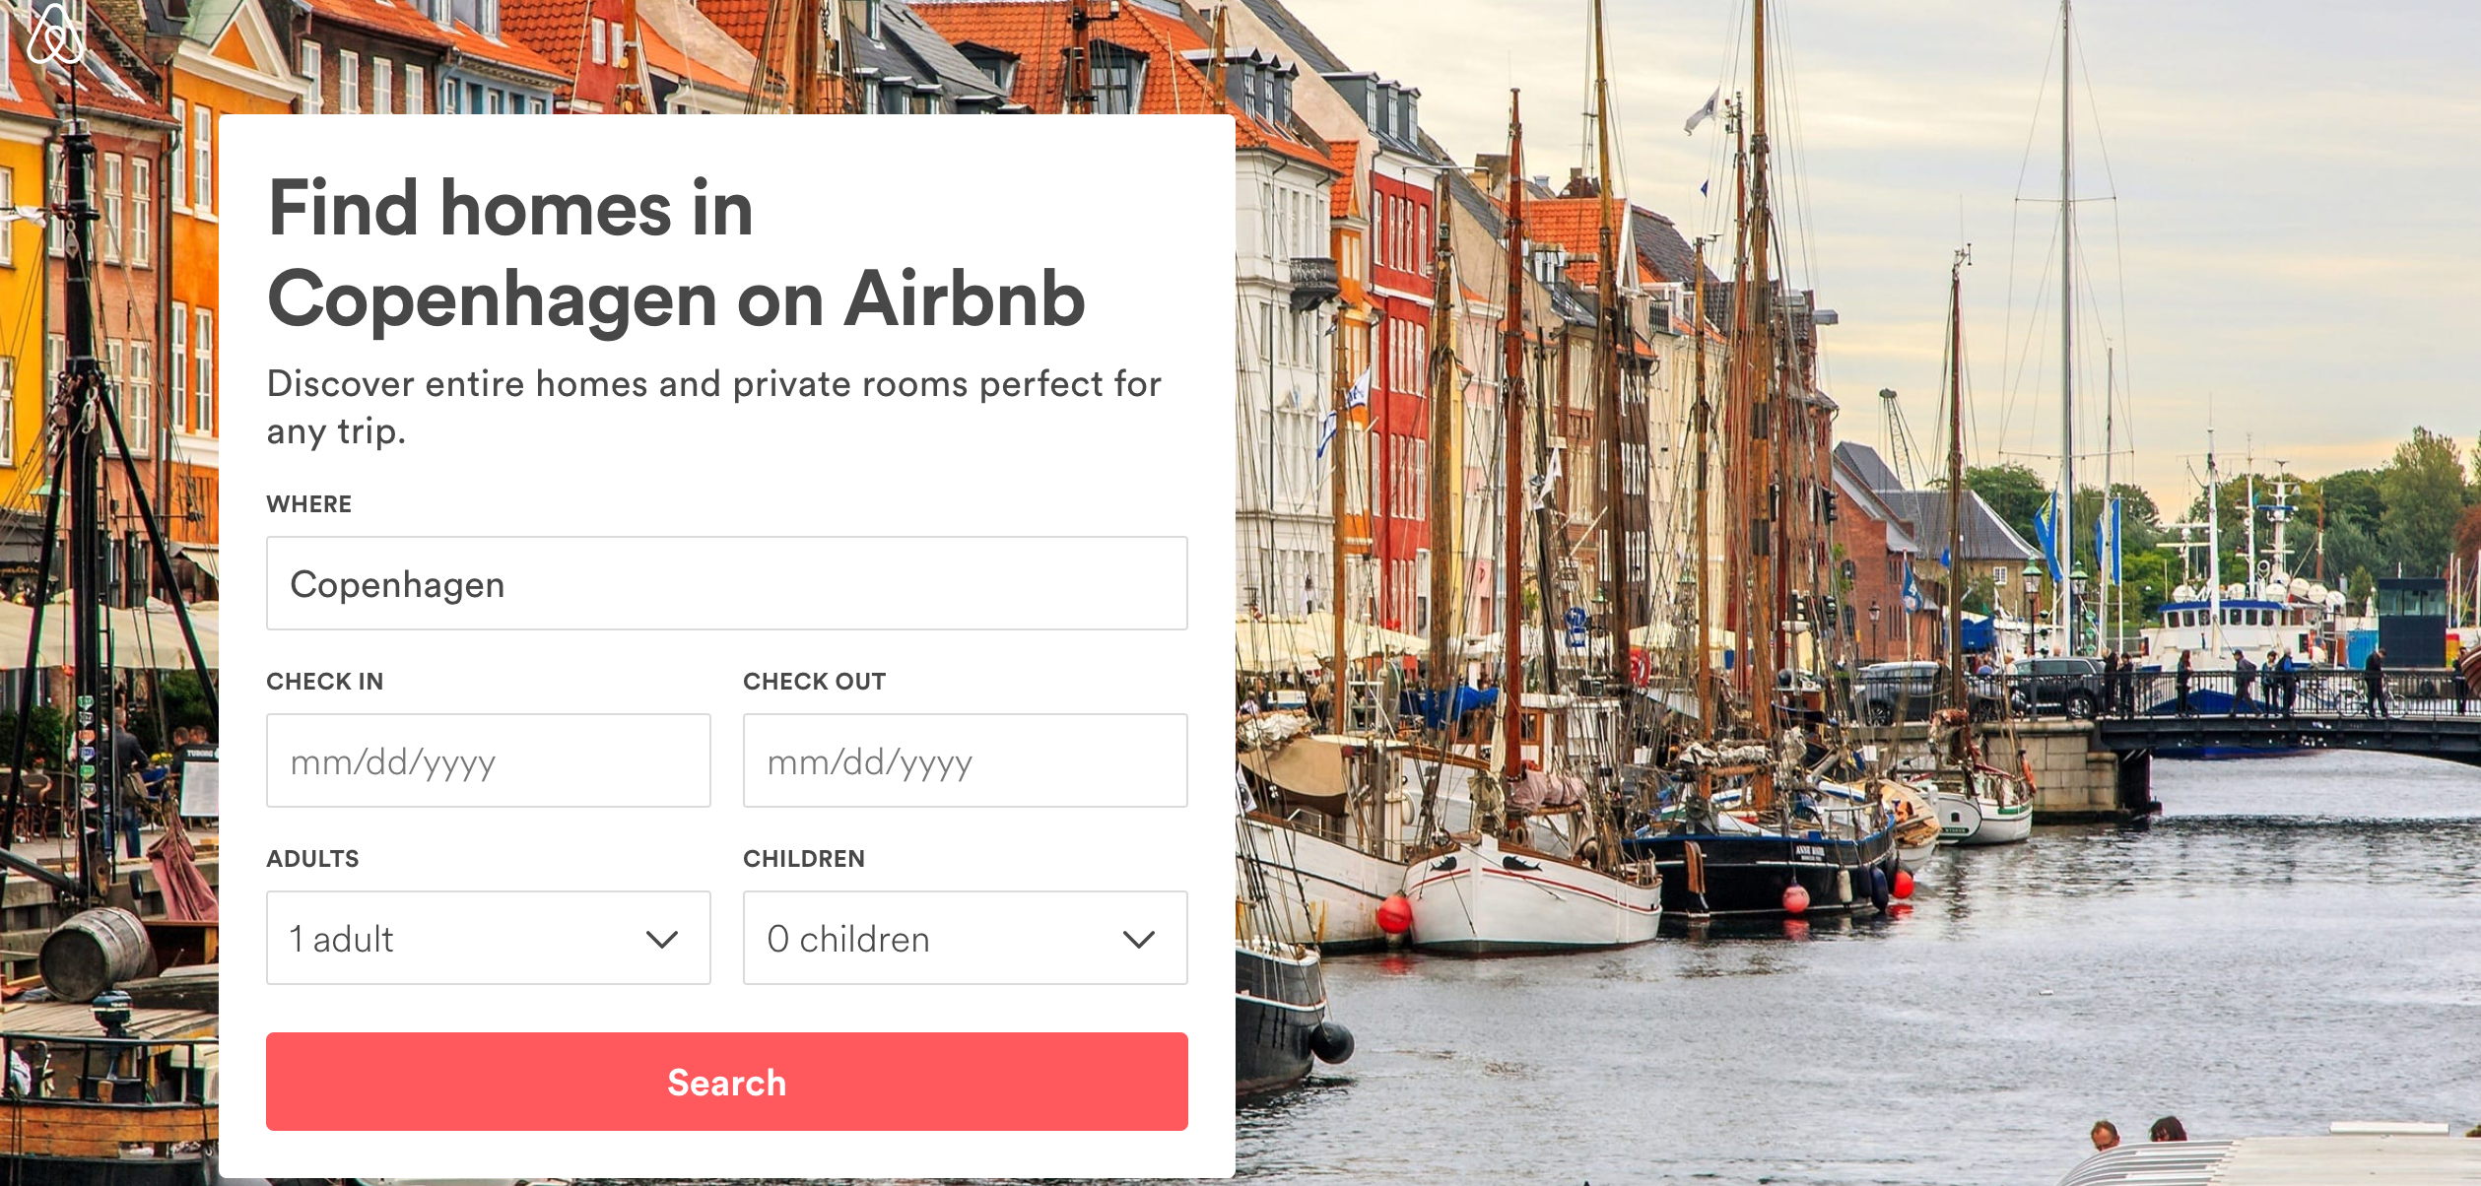

Slide 11
Neighbourhoods in Copenhagen

Slide 12


LAX CPH
Duration: 10h 40min
Price: $295

Slide 13
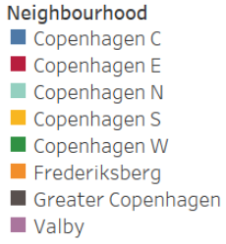
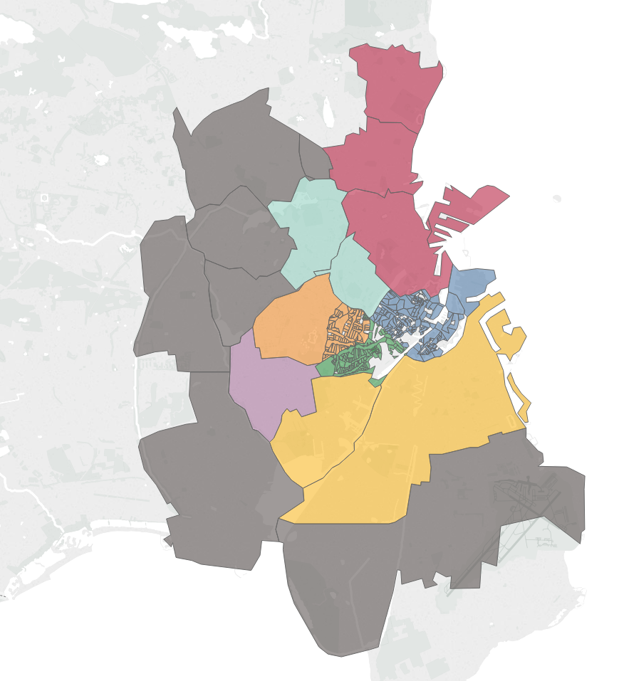

Denmark
Population: 5.7 mil.
Northern Jutland
Viborg
Copenhagen
Pop.: 1.1 mil.
Ringkøbing
Aarhus
Vejle
Ribe
Western Zealand
Roskilde
Fyn
Southern Jutland
Storstrøm
Bornholm

Slide 14
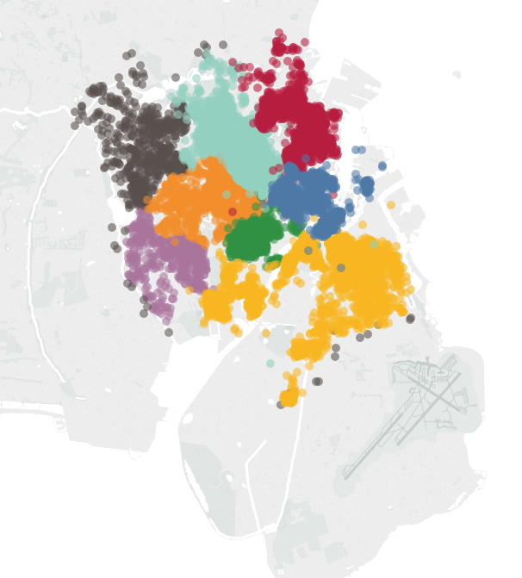
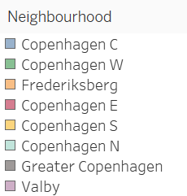
Copenhagen C
Copenhagen W
Frederiksberg
Copenhagen E
Copenhagen S
Copenhagen N
Greater Copenhagen
Valby
Average price
Minimum Maximum
$142
$135
$128
$122
$119
$113
$109
$107
$306
$291
$309
$302
$298
$307
$295
$248
$23
$19
$16
$15
$11
$11
$19
$17

Slide 15
The data

Slide 16
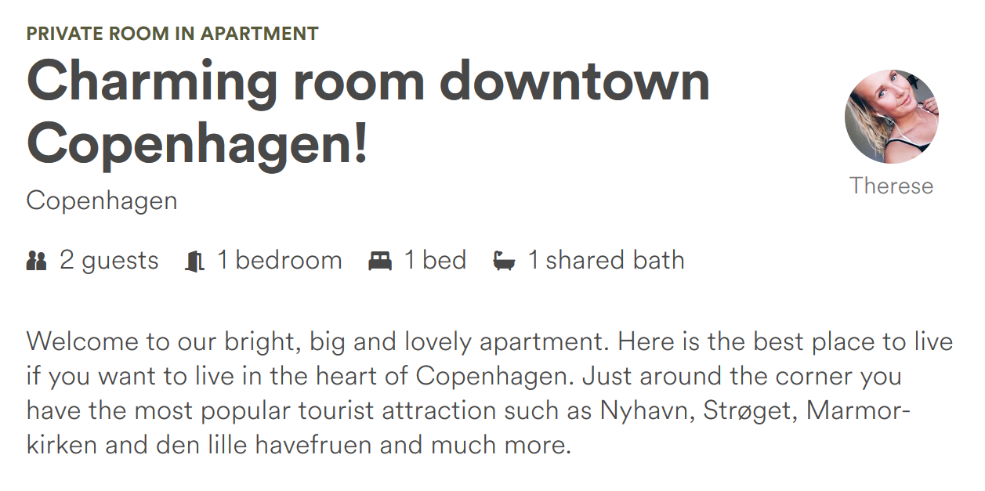
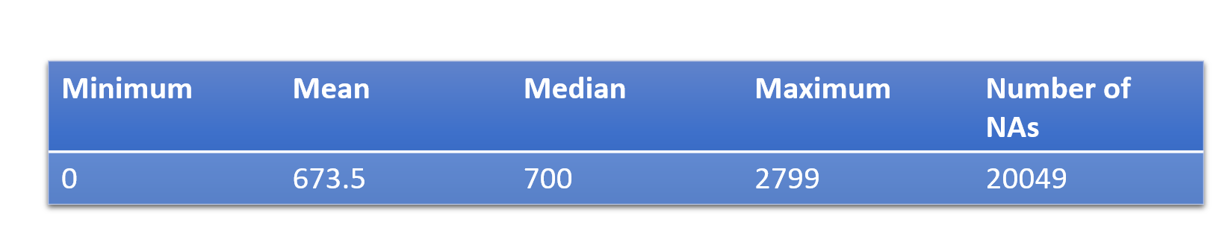
Initial Problem
Square Feet as a predictor
Not enough observations
Most intuitive aspect

Slide 17
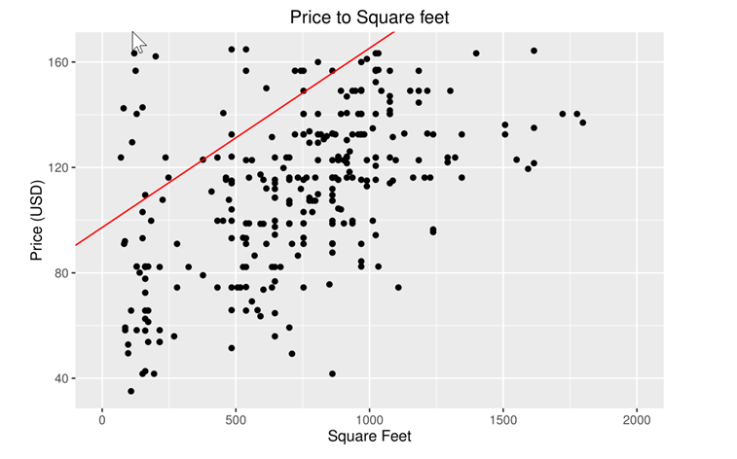
How useful would Square feet have been?
Clear trend
Incorrect data
Improper values inputted
Smaller than is legally allowed
Was it properly measured?

Slide 18
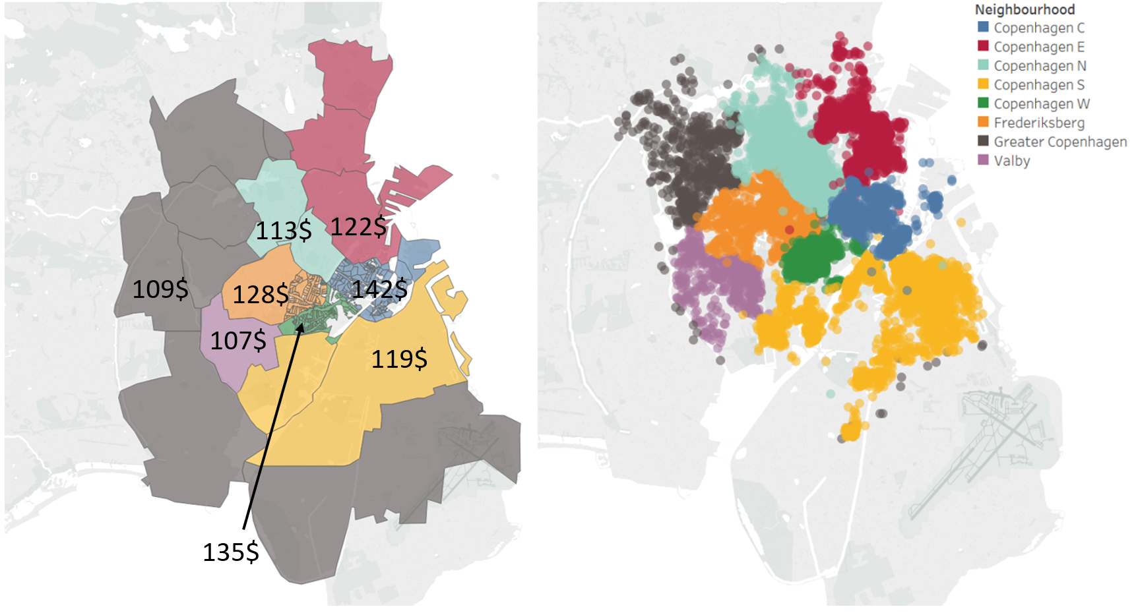
Investigating Mean Price Per Area

Slide 19
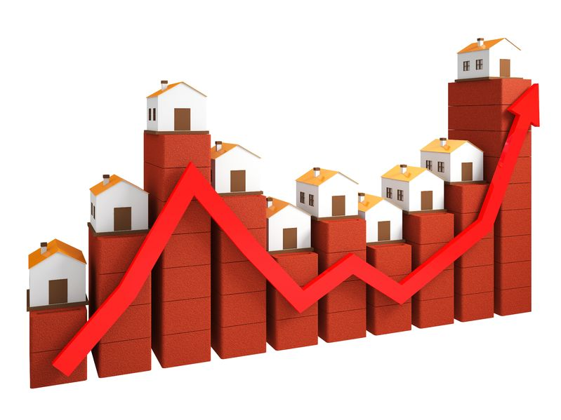
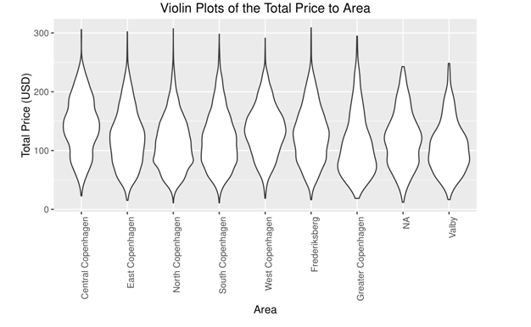
Further investigating the Price per region

Slide 20

Frequency of Listings per Area

Slide 21
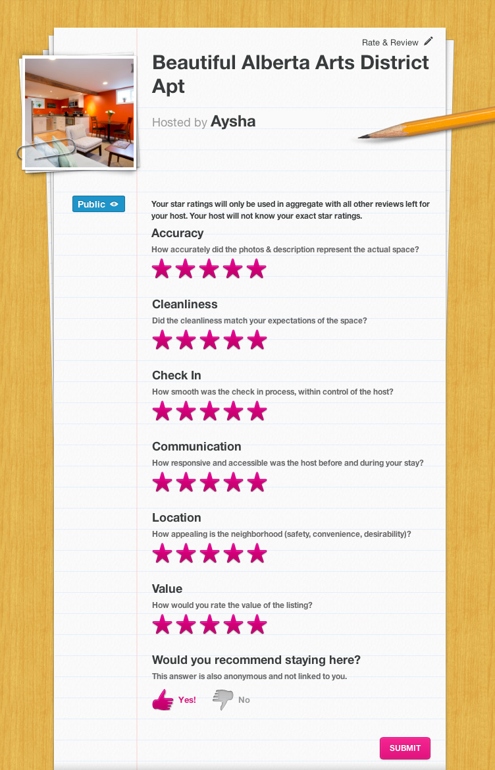
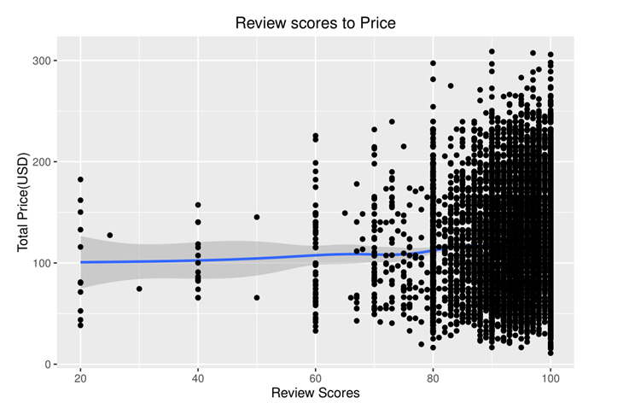
Looking into Review Scores
Notes:
Review scores under 80 are sparse
Creates uncertainty
It does increase quite a bit after 80, so definitely a variable to keep in mind when looking at the total price

Slide 22
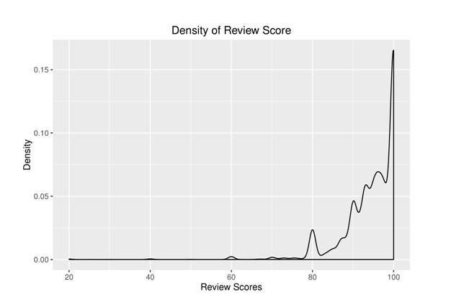

Investigating the reliability of Review Scores
Notes:
Was their experience really what they claim?
Do they just give max rating if they had a satisfactory experience?
Do they fear getting a low user review as a result?
Or do they just not care to give a thorough review?

Slide 23
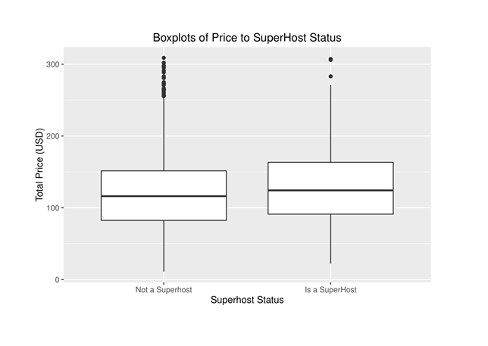

Looking into Superhost Status
Superhosts earn 22% more
than other hosts and benefit
from a variety of rewards

Slide 24

The pattern observed
Difference seems small
Sample Size is large
Predictor is significant

Slide 25
Pricing decisions

Slide 26

Pricing decisions as a host
New host – how to price?
Maximum number of guests?
Pricing your Airbnb listing can be difficult
Lack of information?
Add an additional bed?
How to get answers to such questions?
.
.
.
Utilize the available data to make a pricing model!
Use the estimates to make informed decisions!

Slide 27
Modelling implicit prices & estimation
Airbnb listings – heterogeneous goods traded in a single market
Use available measureable characteristics to decompose the price of the listing into implicit prices of measurable characteristics
Advantages: Using (most) of the information that consumers face in the model
Disadvantages: Unobservable characteristics that affect pricing and missing variables (e.g. pictures)
Some variables should be viewed as decision variables – others are control variables that cannot easily be changed by the host (short-term)
Entire home
Private room
Number of reviews
Review scores
Primary decision variables
Bathrooms
Bedrooms
Host characteristics
Booking characteristics
Guest capacity
Number of beds
Hedonic pricing model
Neighbourhoods
Implicit prices of the elements of a listing

Slide 28










Choosing guest capacity and number of beds
Important price determinant: Number of guests allowed – however, decreasing effects on price
Combing with the price effects and costs from an additional bed, a host faces a trade-off
Could use the estimates to make cost-benefit analysis of adding an additional bed
+1%-cost of bed
+12%-1% per guest
Vs.

Slide 29

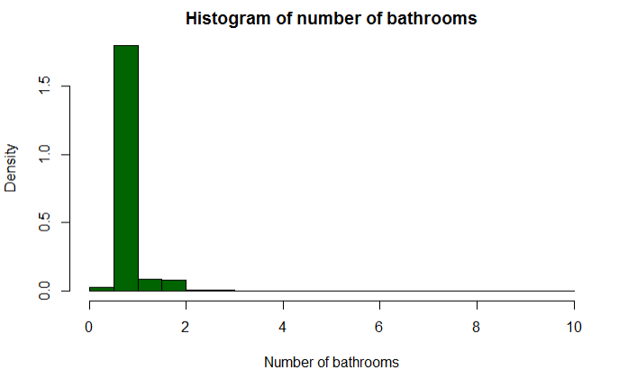
Bedrooms & bathrooms
As expected, each additional bedroom is associated with a 7.4% increase in price.
Each additional bathroom is associated with a 3.6% increase in price
However, due to historical reasons, there are very few listings with more than 1 bathroom
Notes:
More control variables than decision

Slide 30




Number of reviews and rating
The number of reviews’ effect on for a given listing on the price is negligible
Each additional review is associated with a relatively small 0.04% increase in price
In the data, the review rating is measured on a 20-100 scale, but is shown to users rounded to nearest half-stars. Scale goes from 1-5
Each additional half-star is associated with a 1.67% price increase
Hosts should focus on quality rather than quantity when it comes to reviews

Slide 31


Host characteristics
A pro host (i.e. 2 or more listings) succeeds in charging a 3.4% higher price
Suggests a skill premium or learning-by-doing effects on pricing abilities
Superhost status is determined mechanically by Airbnb
Being a superhost is associated with 7.1% price increase
Highly rated
4.8+ review rating
Example from Airbnb:
Responsive
90%+ response rate
Airbnb’s superhost criteria
Determined each quarter
Active
10+ visitors per year
Superhosts receive a badge on their listing, which acts as positive signal to the consumer
Reliable
0 unjustified cancellations

Slide 32
Neighbourhood controls
The price difference across the 7 neighbourhoods are estimated with reference to the eighth neighbourhood Copenhagen C
Almost same pattern as descriptive summary statistics
However, Valby is now relatively cheaper than Greater Copenhagen
-16%
-23%
-33%
-12%
-6%
Listing part of or your whole home?
-30%
-20%
Compared to shared room, a private room is 50% more expensive
An entire home is 93% more expensive

Slide 33
Conclusion and further remarks

Slide 34
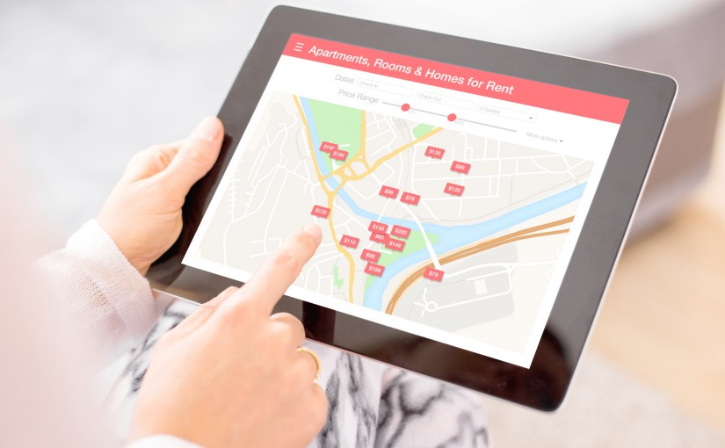
”How does listing characteristics, reviews, host characteristics, location etc. affect the pricing of Airbnb listings in Copenhagen?”
Problems in the data
Square footage variable
NA’s in general
Further investigation of the implicit price of listing characteristics
Comparison with LA
Other possible robustness checks

Slide 35
Appendix

Slide 36
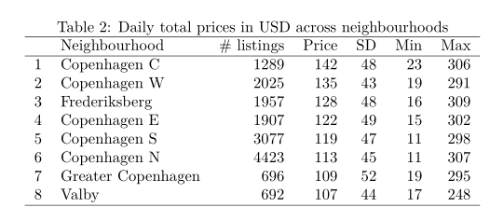
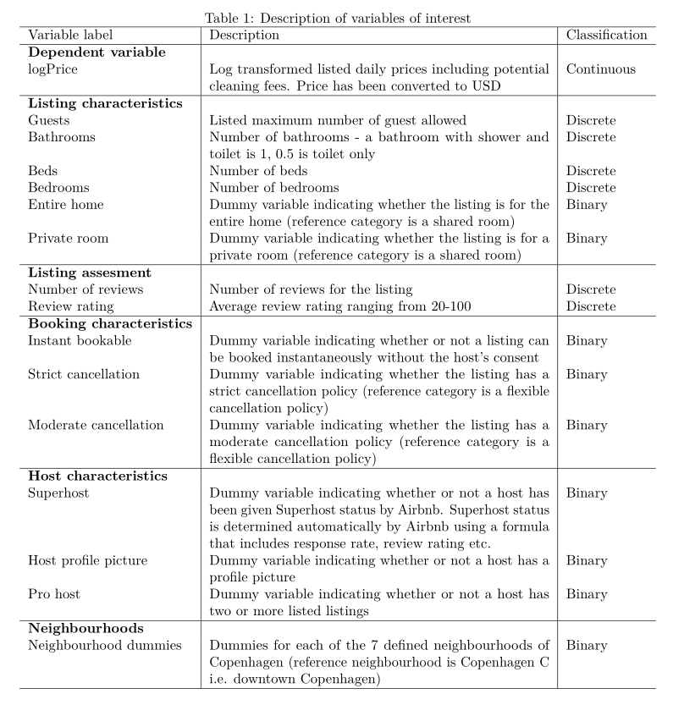

Slide 37
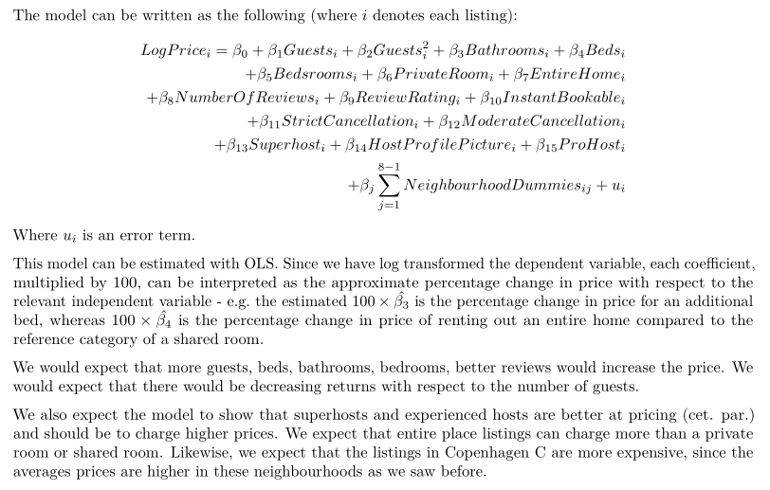

Slide 38
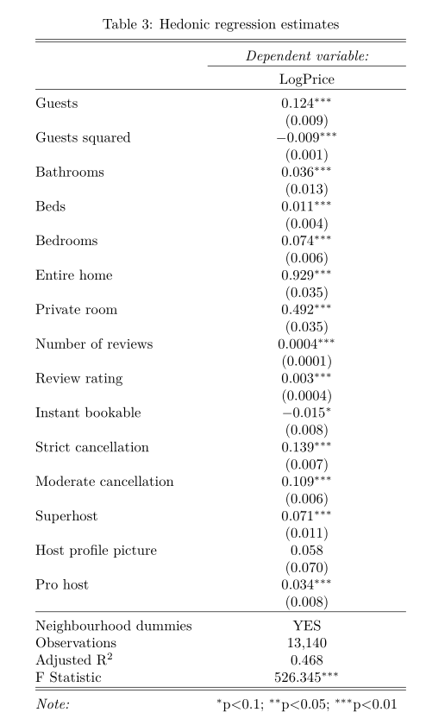
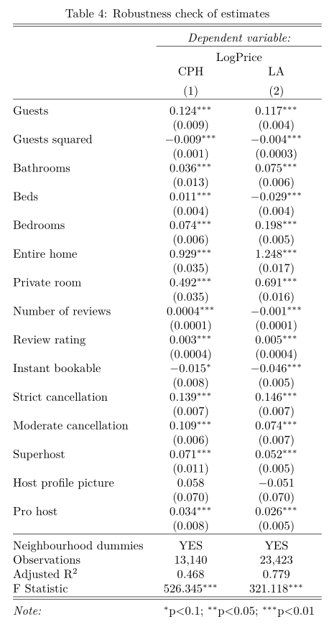

Slide 39
